Slide 1

filecreator
PASS
CS532: OS Foundations
Lab Assignment
Email: chitram2@pdx.edu & ramya3@pdx.edu

Slide 2
Instructions: Make a copy of this document, move your copy to your submissions folder and fill the document with your responses. Use the space on each slide to show your responses, and add additional slides as needed.
When ready for grading: complete the lab assignment submission form and include a link to your filled document

Slide 3
Your assignment is to write a new program, called filecreator.c. It should accept four command line parameters (d = location of directory, f = number of files to create, r = number of integers to insert into each output file and t = number of threads).
it should assume that d exists and give an error if d does not exist or cannot be written to.
then it should create f files in the directory d. each output file should be named "unsorted_<id>.bin" where <id> is a unique integer from 0 to (f-1).
in each output file the program should write r random 32-bit integers. each integer should be chosen randomly by the rand_r() function. note that the output files must be binary. not ascii.
finally, make this program multi-threaded such that each of t threads creates approximately f/t of the files.

Slide 4
Your source code may NOT use these C language functions: fopen(), fclose(), fread(), fwrite() and related functions. use rand_r() for generating random numbers (do not use rand() or any other method for generating random numbers, use rand_r() only). use any of the pthread functions.
instead of fopen, foclose, etc. use these linux system calls: open(), close(), write() and if needed read(). these are described in section 2 of the linux manual, so you can find documentation using the "man" command at the linux shell. like this:
man 2 open
man 2 close
man 2 write
man 2 read
(you can also find the same information via googling)
If you have questions about whether a specific API is allowed then contact me first. but the main thing I disallow is fopen(), fclose(), fwrite(), fread() and related functions.

Slide 5
Run your program with these inputs:
./filecreator $(pwd)/unsorted 10 1 1
./filecreator $(pwd)/unsorted 100 2 1
./filecreator $(pwd)/unsorted 1000 10 1
./filecreator $(pwd)/unsorted 10 1 2
./filecreator $(pwd)/unsorted 100 2 2
./filecreator $(pwd)/unsorted 1000 10 2
(and try many more inputs to convince yourself that it is working properly)
the above notation, specifically the $(pwd) part has been tested on the department's linux servers, but if you are using a different type of system then you might need to update it a bit. if you are having issues then test it with "echo $(pwd)" to see if $(pwd) corrrectly prints your current working directory. If not then replace the $(pwd) with the full pathname of your current working directory.

Slide 6
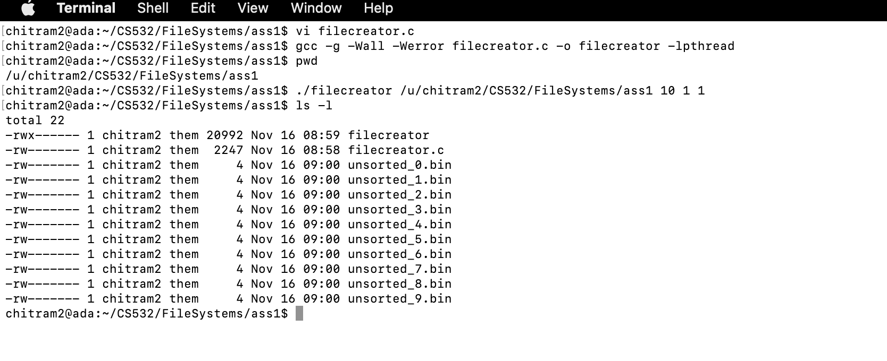

Slide 7
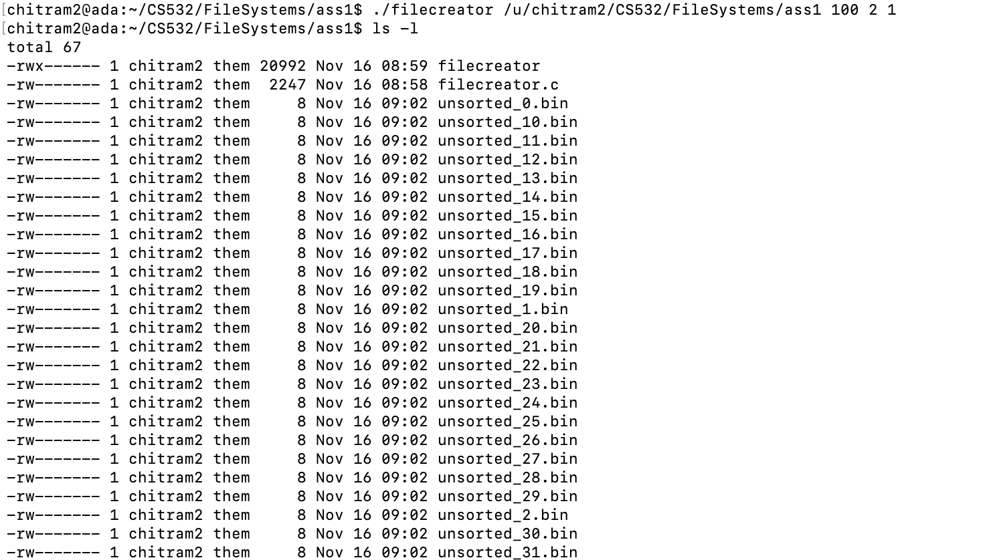

Slide 8
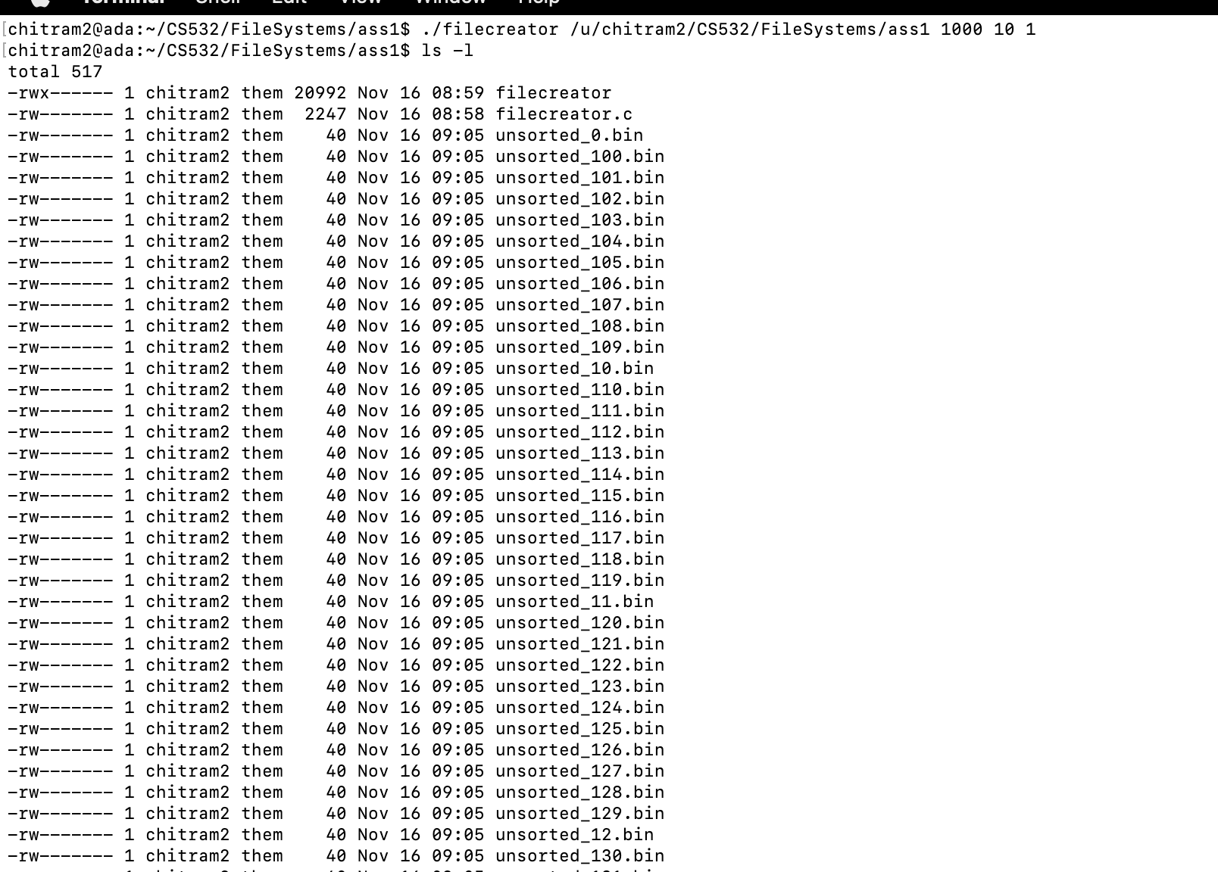

Slide 9
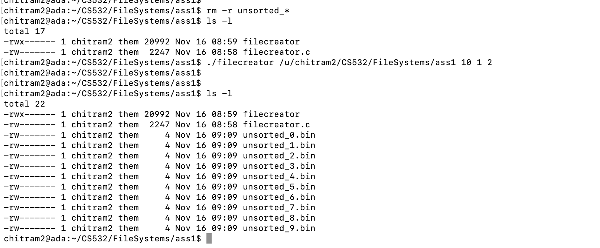

Slide 10
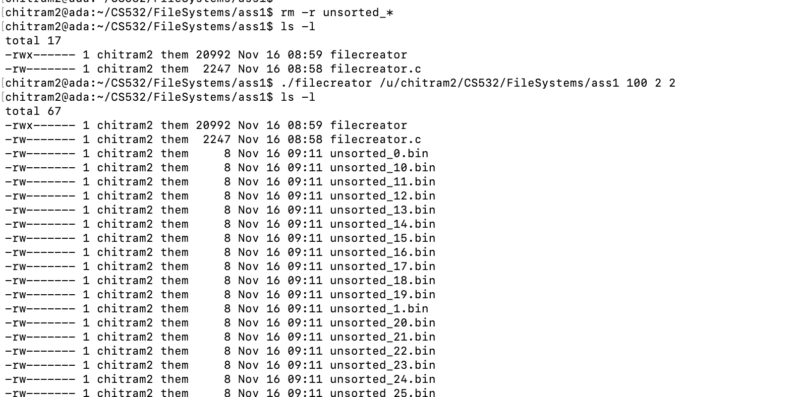

Slide 11
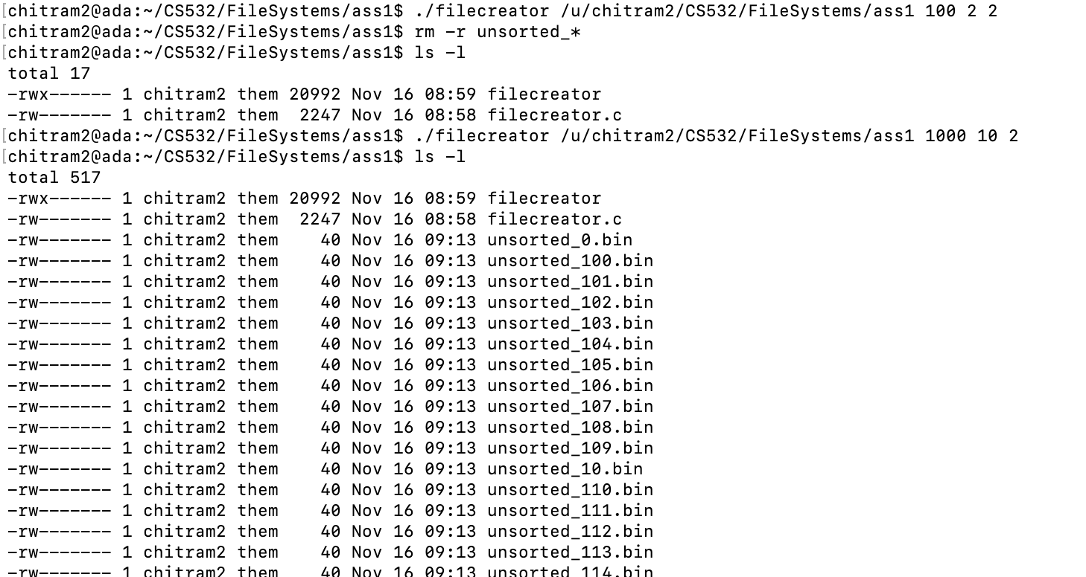

Slide 12
1. Upload your filecreator.c file to your submissions folder and provide a link to it here: link
https://docs.google.com/document/d/1KVxosmX_XHzrecBL9wb8lQw3AsQoPHAR/edit
I will take your source code and test it in the following ways:
Can it create 1000 files?
Are the created files all of the correct size?
Does the program correctly detect when the directory does not exist or is not writeable (it should exit with an error in these cases)?
Plus possibly some more tests to be determined.
All tests pass. Nice work.

Slide 13
2.
Even though Linux does not technically support typed files, it does provide a utility (called 'file') that allows us to determine whether a file is binary, ascii text or a legal executable.

Slide 14
2A. Use the file command with filecreator.c, filecreator (or a.out), and one of your unsorted_xxx.bin files as inputs. What does the file command indicate for each of the files:
 | Type of file as indicated by file command
filecreator.c | filecreator.c: C source, ASCII text
filecreator | filecreator: ELF 64-bit LSB pie executable, x86-64, version 1 (SYSV), dynamically linked, interpreter /lib64/ld-linux-x86-64.so.2, BuildID[sha1]=efbeb5d5084197add8aa43866549336e9ba09634, for GNU/Linux 3.2.0, with debug_info, not stripped
unsorted_xxx.bin | unsorted_1.bin: data

Slide 15
3. Create 100 files each with 10000 integers, like this:
./filecreator $(pwd)/unsorted 100 10000 10
Binary files are not easy to read and manipulate. We can't easily edit them in a text editor, print them to the terminal or search for strings using 'grep'. No worries, the linux utility 'hexdump' can help.
Use the unix utility 'hexdump' to examine the contents of one of your unsorted_xxx.bin files. read the hexdump man page or use google to learn how to print 32 bit integers from a binary data file.
For example, try hexdump -v -e '1/4 "%08d " "\n"'with one of your files.

Slide 16
3A. Do any of your unsorted_xxx.bin files contain integers between 555555 and 777777? What percentage of numbers are in this range? HINT: one way to do this is to write a small python script to check whether an input number is within the range, and then pipe the hexdump output through this script, like this:
hexdump -v -e '1/4 "%08d " "\n"' | python3 myscript.py
This is only one way to solve the problem. You could also use a spreadsheet or other techniques to do it.
Answer
0.01% of the numbers are in this range
good

Slide 17
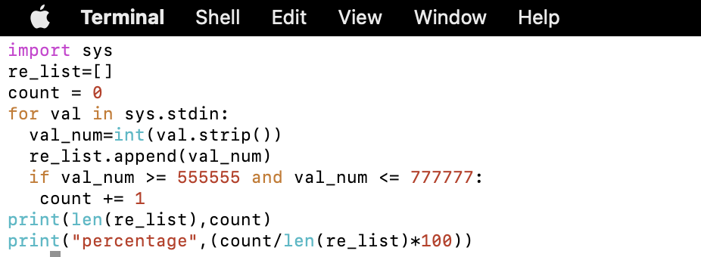
3B. Describe how you went about determining your answer for 3A. If appropriate show the commands that you used.
Answer
I created a script for reading the file and then checking if condition to calculate the percentage in the number of matching files in between 555555 and 777777
Good

